Slide 1
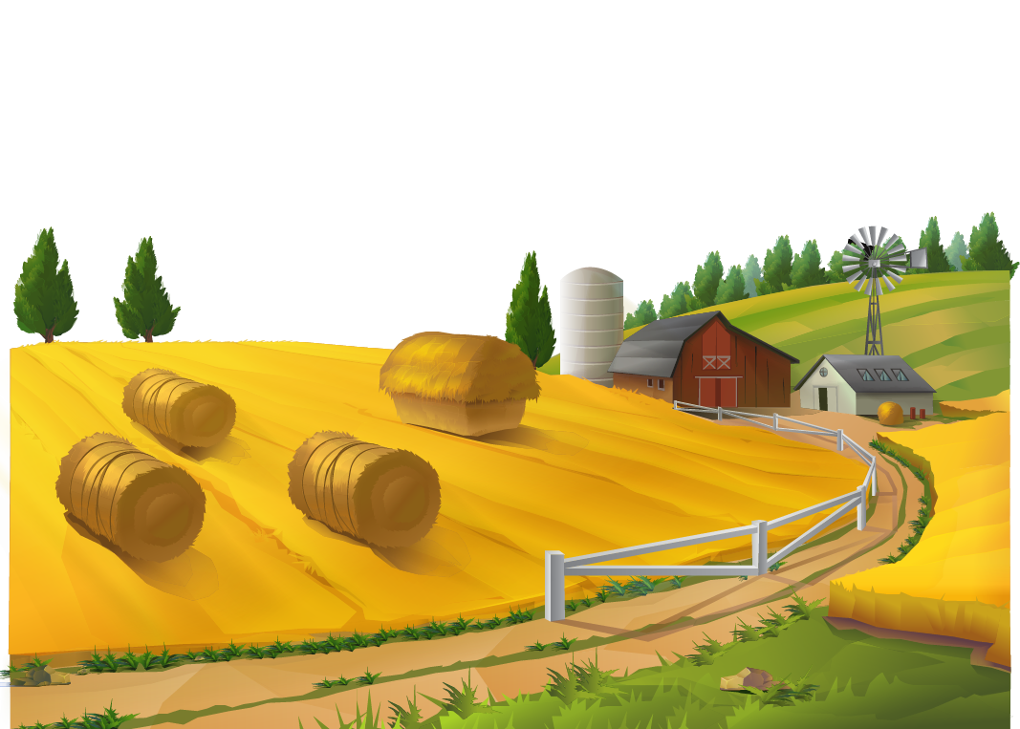

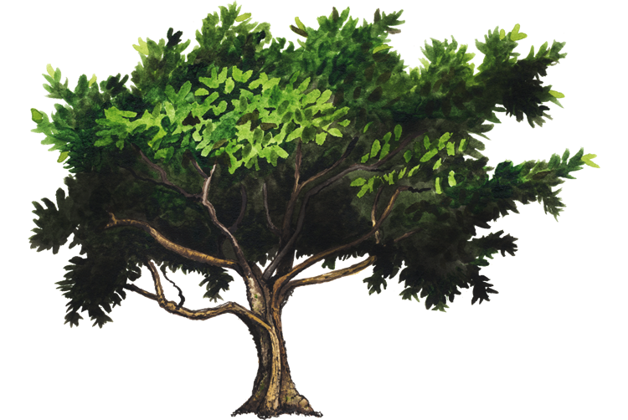
Urban life and Rural life
By
Pawan Mahadu Sarule
Class: FYBCA(sci)

Slide 2

Introduction
What is society?
A group of people living together in an ordered community .
Origin of human society
Rural Society
Urban society

Slide 3
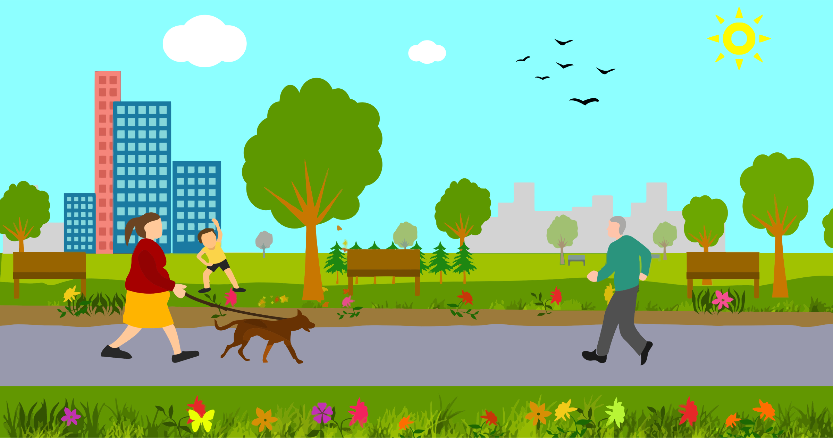
Origin of Urban Society
Technological developments
Industrial Revolution
Increased trading interaction
Emergence of port cities as trading hubs
Demographic expansion

Slide 4
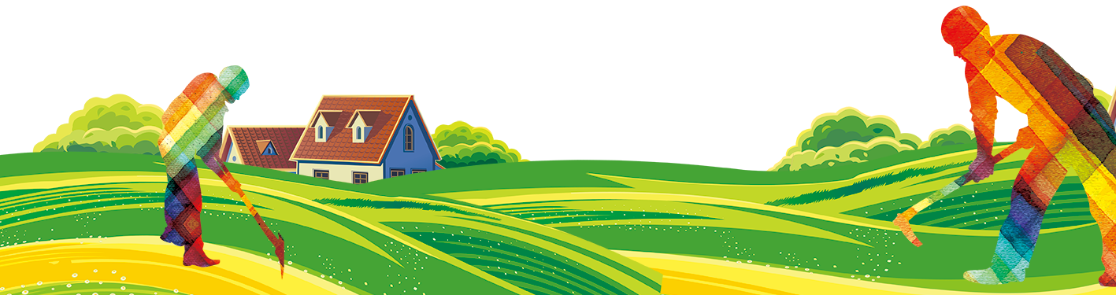
Origin of Rural Society
Domestication of animals and agriculture
Began around 20,000 BC
Early human settlements emerged
Indus Valley Civilization

Slide 5
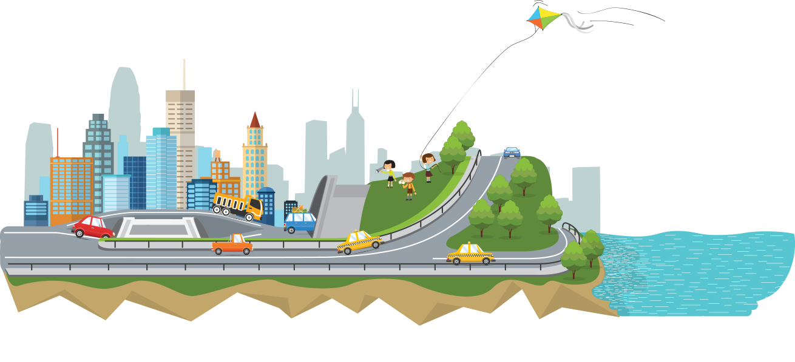
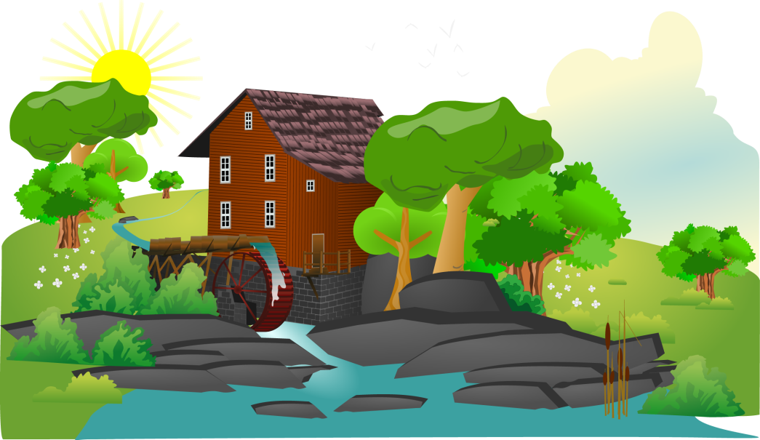
Difference b/w Urban and Rural Life
Environment
Close contact with nature
More influenced by natural phenomenon
rain, heat, drought etc
Isolated from nature
Human control over environment
More polluted environment
Rural Society
Urban Society

Slide 6
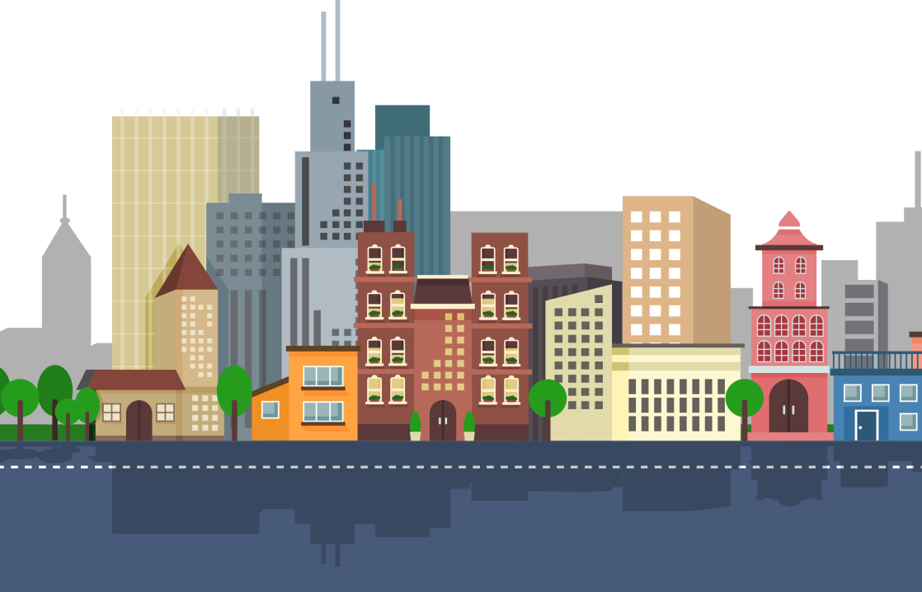
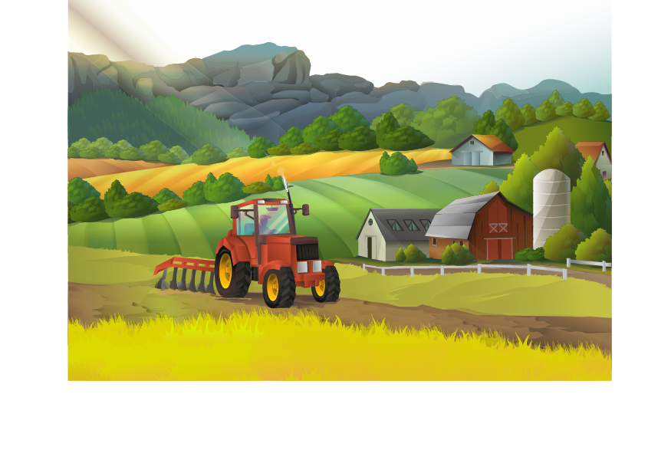
Population
Rural Society
Urban Society
Small community size
150-200 households per community
Population in thousands
Low density of population Urban Society
Very large community
Thousands of households
Population in Millions
High population density

Slide 7

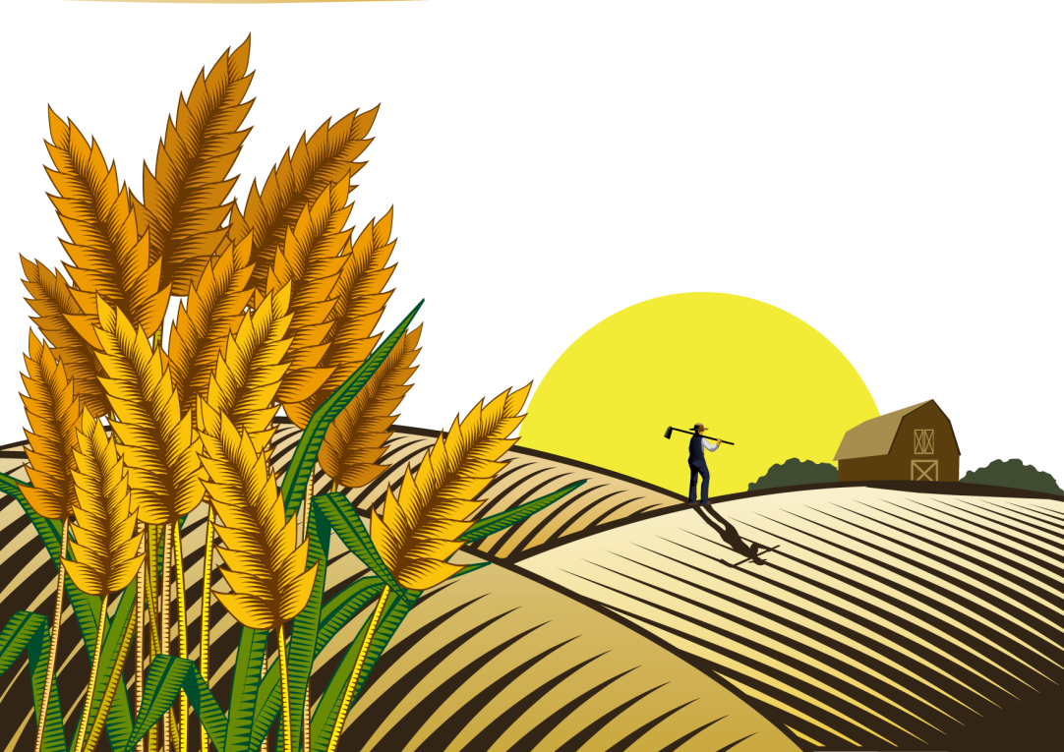
Occupations
Urban Society
Rural Society
Wide range of occupational choices
Services industry and technology assistance
Agriculture is the primary occupation
Labor intensive manual work more prevalent Urban Society

Slide 8
Thank
You

